Slide 1
31 July 2021

Slide 2
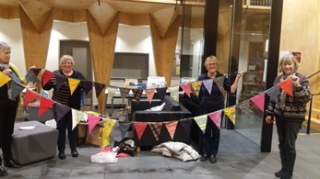
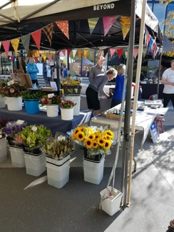
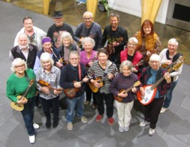
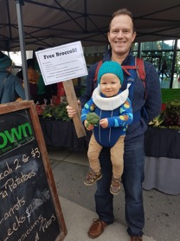
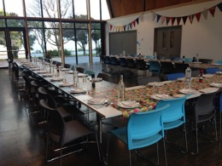
MPCC Update…..
Our Social Enterprises:
Farmers Market every Saturday
Arts & Crafts Market every 2 months
Front Room Café – Community Hub
Venue Hire – weddings, birthdays, funerals,
Pink Ribbon Public Meetings….
Classes – 50+ per week
Community Activities:
  Mt Pleasant Singers
  Stitch in Time
  Playgroup
  Soup & Show *
  Community Garden
  Mt Pleasant Ukulele Band
  Matariki
  Estuary Festival
  Ways to Wellness programme*
  Speakers Corner*
Notes:
Pleased to be part of this ever growing & developing vibrant community.
We are proud to be one of only 2 community centres owned by our residents assoc.
Have always had a focus on providing a place for people to meet, learn, grow and feel supported.
We operate on a social enterprise model which means any profits go to the development of community activities.
Community Activities have grown….Singers one of the first – started with 8 people of whom 4 were related to me!

Slide 3
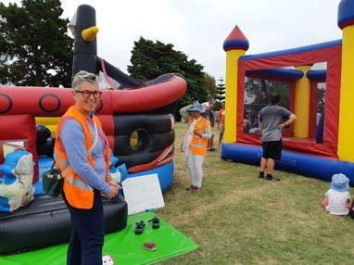
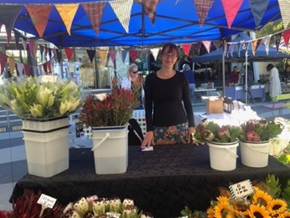
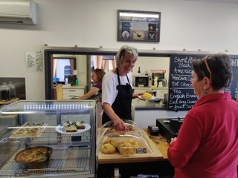
Amazing Members and Volunteers
264 Members
Average of 250 Volunteer Hours Per Month!!

Slide 4

2021 Survey …..
Last survey was conducted in 2018
Ran for the month of April 2021
108 respondents

Slide 5
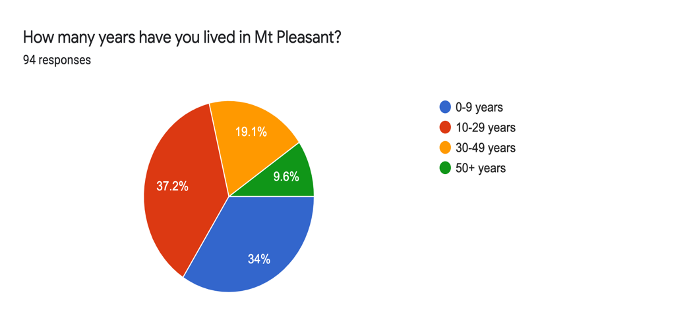
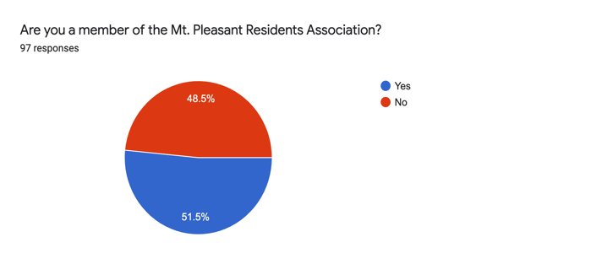

Slide 6
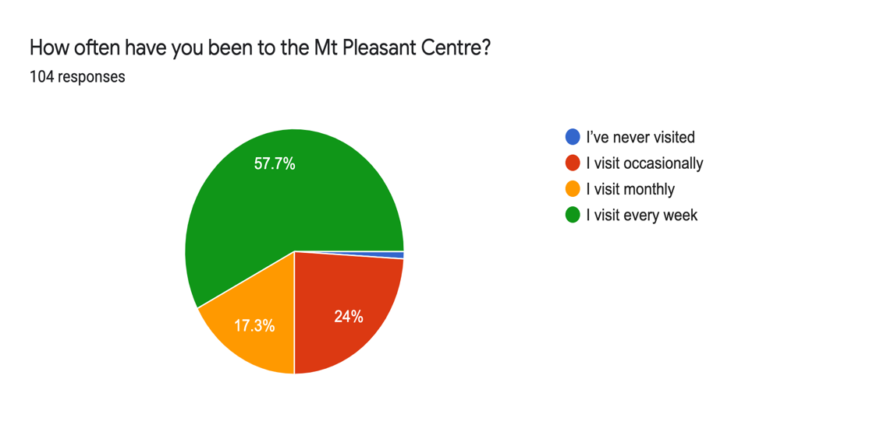

Slide 7
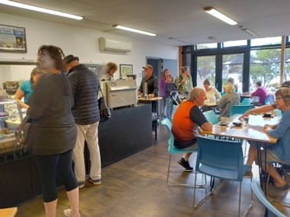
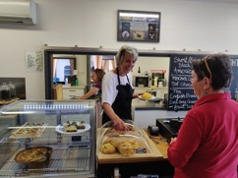
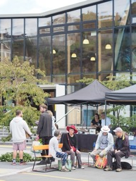
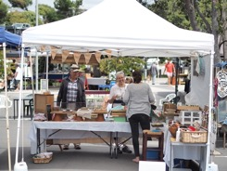
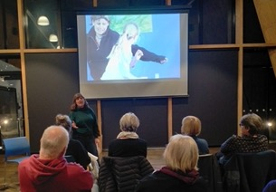
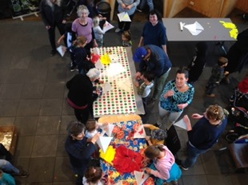
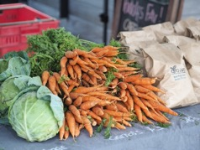
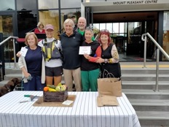
What brings you to the centre?
Front Room Café
Classes, Events, Community
Farmers Market

Slide 8

What NEW Activities would you like to see at MPCC?

Slide 9
Exercise Classes:
Tai Chi **
Pilates **
Meditation

Slide 10
Language classes:
Te Reo Māori
NZ Sign Language

Slide 11
Community Social Events
Movie Nights
Quiz Nights
Games nights

Slide 12
Sustainable
Living
Horticulture
Permaculture
Classes
Swap Meets
Plants & Clothes
Climate Change Watchdog group
Landscape
Design
Ride sharing
Car pool up the hill
Equipment sharing – trailers, chainsaws etc

Slide 13

Should we focus some of our efforts on
Estuary Education?
72 people responded to that question
58 people said YES – great idea!

Slide 14

MPCC Current Plans…..

Slide 15
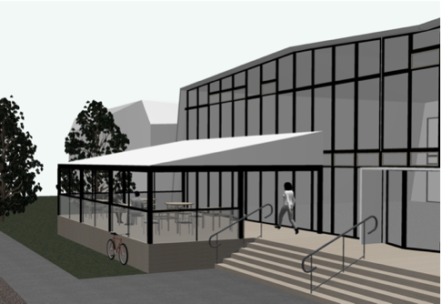


Covering the deck of the Front Room
Improved cycle racks
Developing the ‘community hub-ness’ of the Front Room
  Recognition of ‘Regulars’
  More sustainability – sale of Keep Cups, sale of plants…..

Slide 16
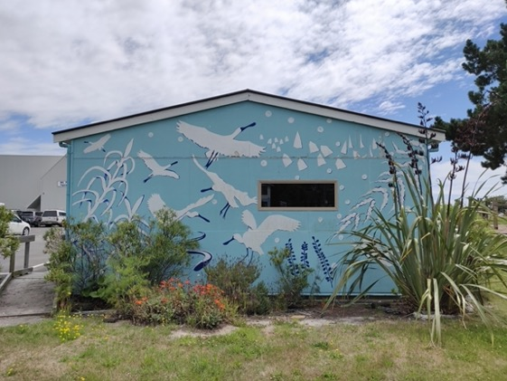
Landscaping the Blue Room area

Slide 17
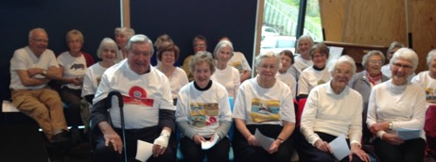
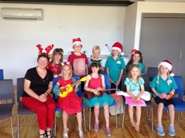
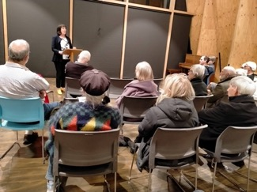
Extending the “Well-Being” talks….
Extending Thursdays for “Soup Plus”
  Soup & a Show = Movie
  Soup & Soul = Well-being talk
  Soup & a Score = Concert
  Soup & a Song = Mt.Pleasant Singers
Continuing Speakers Corner

Slide 18


Now let’s hear from you….

Slide 19


